Slide 1
The (Deleted) Tweets Tell the Story: Fall of Jerry Falwell Jr.
Emily Escamilla
CS 895: Web Archiving Forensics
October 31, 2022

Slide 2
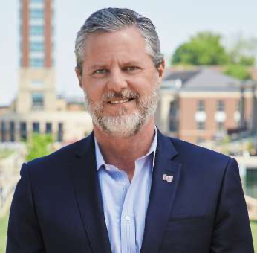
Who is Jerry Falwell Jr.?
President of Liberty University from 2007-2020
Son of Jerry Falwell Sr.
Founded Liberty University in 1971
Increasingly vocal in politics starting in 2016
Interviewed by Fox News
The (Deleted) Tweets Tell the Story @EmilyEscamilla_

Slide 3
Rocky Road for Jerry Falwell Jr.
June 4, 2019
May 27, 2020
June 8, 2020
August 2, 2020
August 7, 2020
Posted and deleted Tweet criticizing David Platt
Posted Tweet criticizing Gov. Northam
Inappropriate Instagram photo
Deleted Tweet criticizing Gov. Northam
Resigned from Liberty University
The (Deleted) Tweets Tell the Story @EmilyEscamilla_

Slide 4
Rocky Road for Jerry Falwell Jr.
June 4, 2019
May 27, 2020
June 8, 2020
August 2, 2020
August 7, 2020
Posted and deleted Tweet criticizing David Platt
Posted Tweet criticizing Gov. Northam
Inappropriate Instagram photo
Deleted Tweet criticizing Gov. Northam
Resigned from Liberty University
The (Deleted) Tweets Tell the Story @EmilyEscamilla_

Slide 5
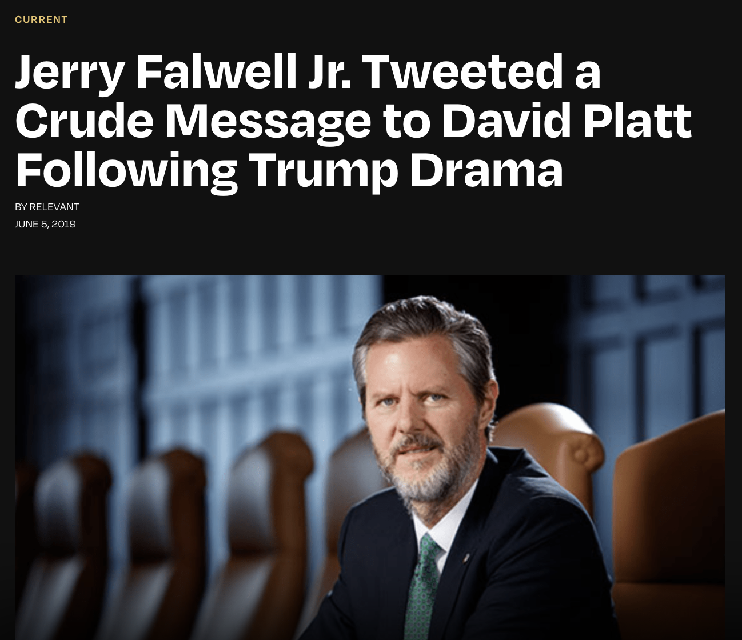
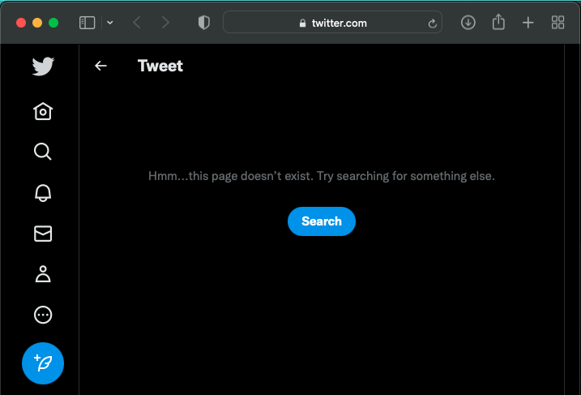
Hunting down the David Platt Tweet
Contained the URL to the original Tweet
Tweet has been deleted
https://relevantmagazine.com/current/jerry-falwell-jr-tweeted-a-crude-message-to-david-platt-following-trump-drama/
https://twitter.com/JerryFalwellJr/status/1135956770931838982

Slide 6
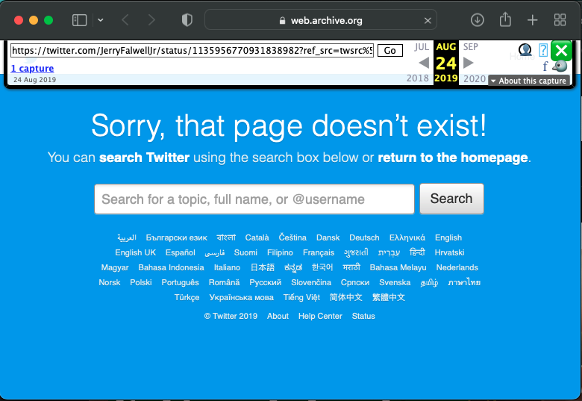
CDX Search on Internet Archive returned 1 memento
Tweet was deleted June 4, 2019
https://web.archive.org/web/20190824192031/https://twitter.com/JerryFalwellJr/status/1135956770931838982?ref_src=twsrc%5Etfw

Slide 7
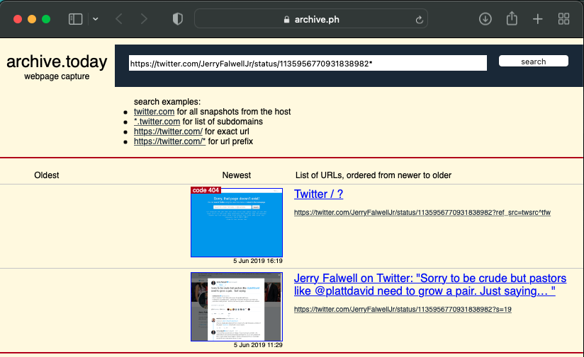
archive.today prefix search returned 2 mementos
https://archive.ph/https://twitter.com/JerryFalwellJr/status/1135956770931838982*

Slide 8
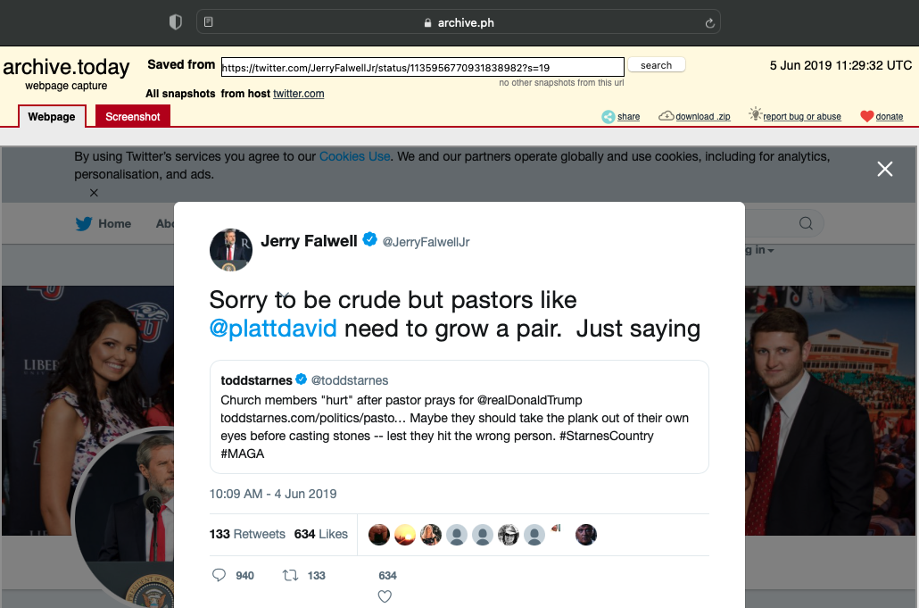
Only 1 ‘200 OK’ Memento of the Tweet
https://archive.ph/6vlAo

Slide 9
Rocky Road for Jerry Falwell Jr.
June 4, 2019
May 27, 2020
June 8, 2020
August 2, 2020
August 7, 2020
Posted and deleted Tweet criticizing David Platt
Posted Tweet criticizing Gov. Northam
Inappropriate Instagram photo
Deleted Tweet criticizing Gov. Northam
Resigned from Liberty University
The (Deleted) Tweets Tell the Story @EmilyEscamilla_

Slide 10
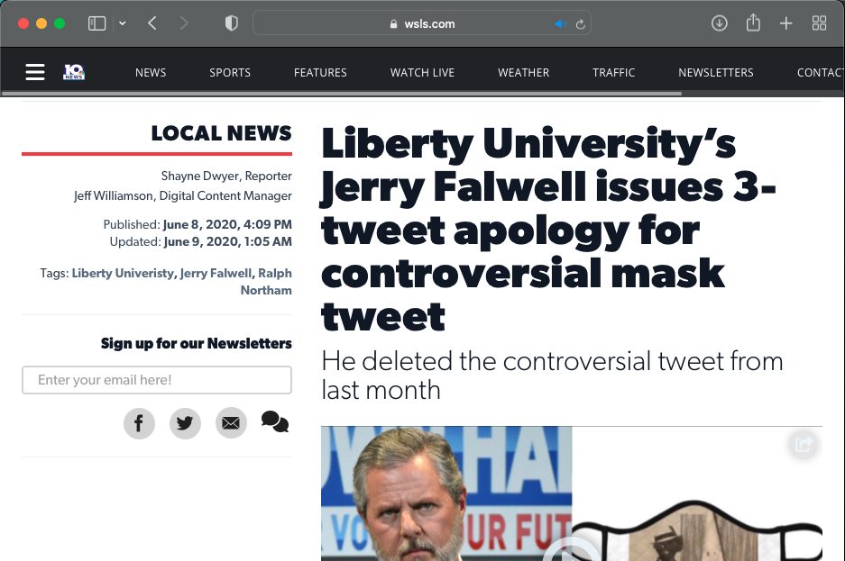
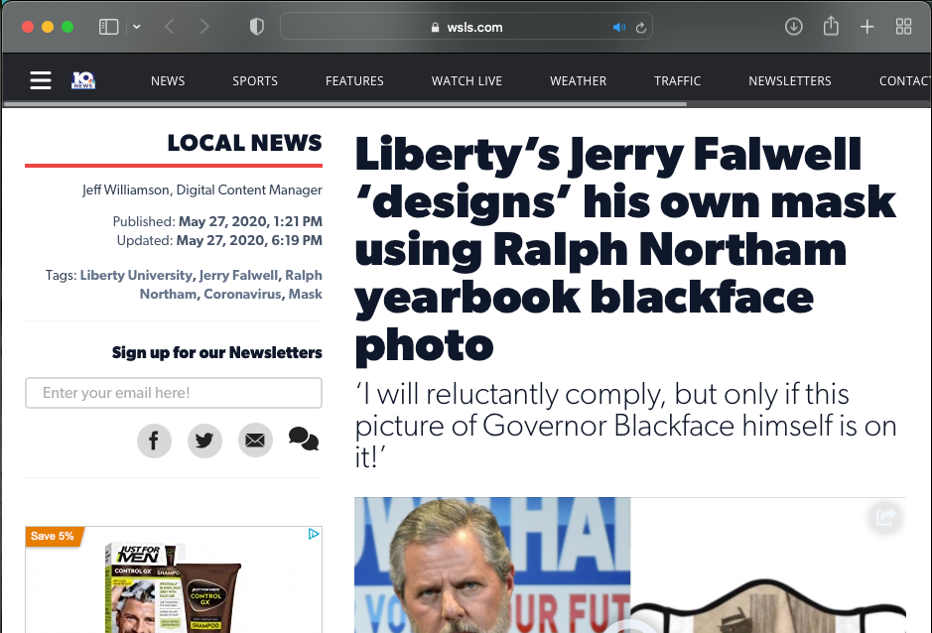
The URL for the Tweet was harder to find
Google search result
Links to Tweet
Links to
https://www.wsls.com/news/local/2020/06/08/liberty-universitys-jerry-falwell-issues-3-tweet-apology-for-controversial-mask-tweet/
https://www.wsls.com/news/local/2020/05/27/libertys-jerry-falwell-designs-his-own-mask-using-ralph-northam-yearbook-blackface-photo/

Slide 11
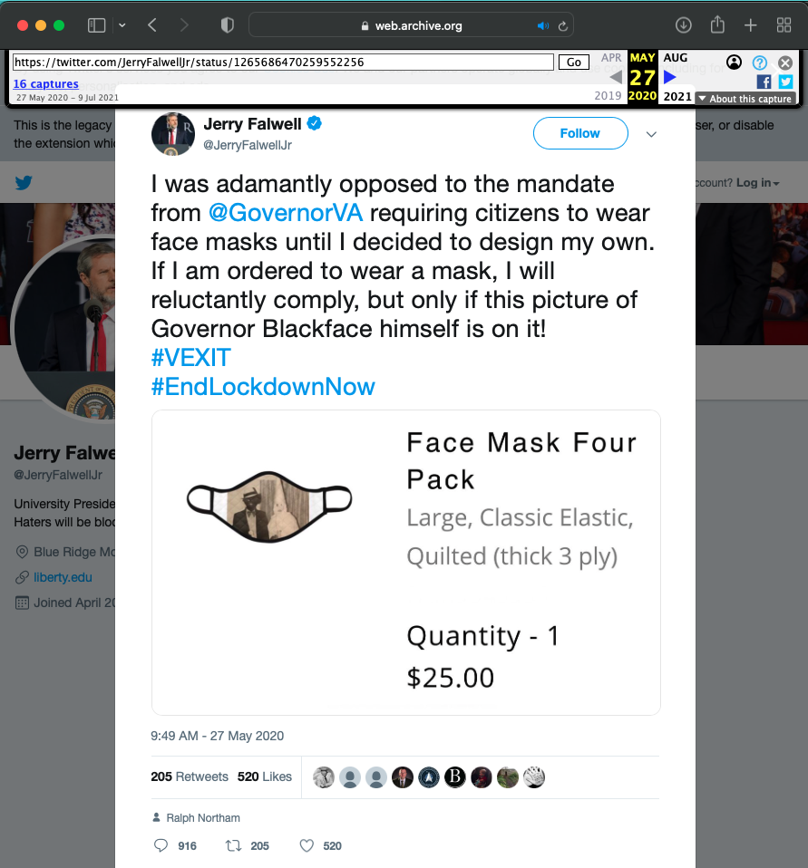
Earliest Memento in IA was May 27, 2020 18:25
16 captures in IA
8 captures of the live Tweet
A few hours after the Tweet was posted
Keep an eye on the engagement
Already 900+ comments
https://web.archive.org/web/20200527182521/https://twitter.com/JerryFalwellJr/status/1265686470259552256

Slide 12
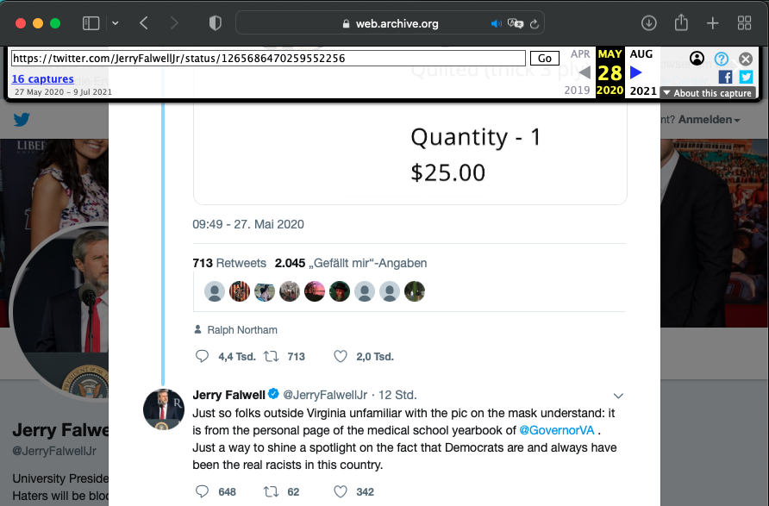
Falwell tried to “justify” his original Tweet
2nd IA Memento
May 28, 2020 10:30
916 → 4.4k comments
205 → 713 retweets
520 → 2.0k likes
https://web.archive.org/web/20200528103046/https://twitter.com/JerryFalwellJr/status/1265686470259552256

Slide 13
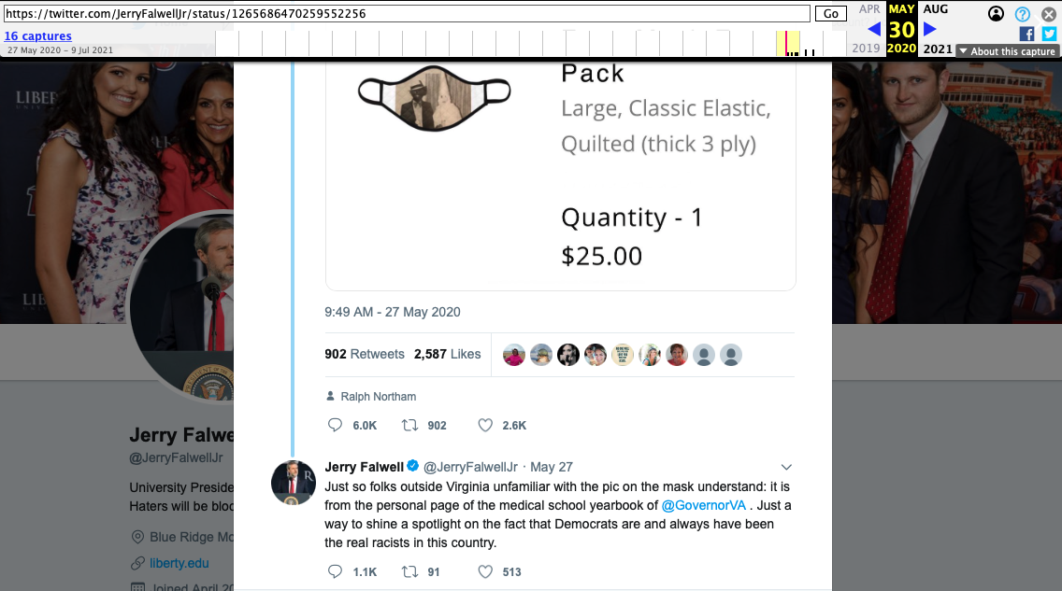
Last Memento in IA was May 30, 2020 12:03
916 → 4.4k → 6.0k comments
205 → 713 → 902 retweets
520 → 2.0k → 2.6k likes
https://web.archive.org/web/20200530120308/https://twitter.com/JerryFalwellJr/status/126568647025955225 6

Slide 14
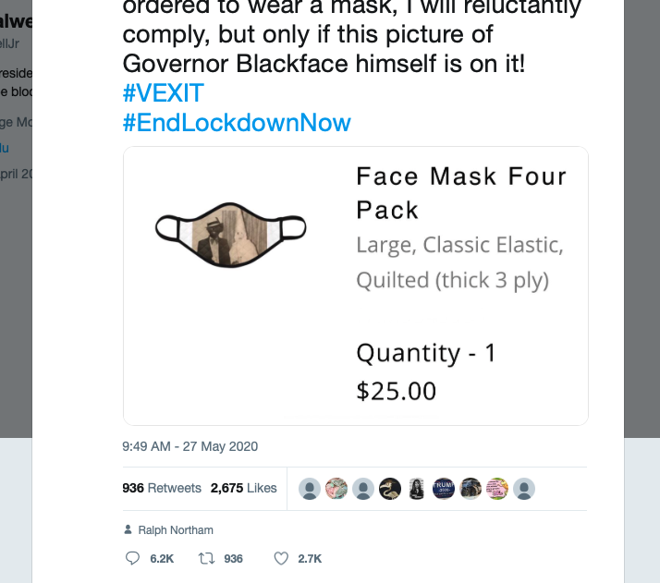
archive.today has the last ‘200 OK’ memento
June 3, 2020 03:40
4 days after last IA memento
916 → 6.0k → 6.2k comments
205 → 902 → 936 retweets
520 → 2.6k → 2.7k likes
https://archive.ph/sHWMD

Slide 15
Internet Archive and archive.today had the most mementos
CDX Search: 104 mementos
Allows a prefix search
Returns Twitter suffix changes
MemGator: 20 mementos for base URL
16 Internet Archive
2 archive.today
2 Library of Congress
archive.today * URI search: 2 mementos
1 ‘404’ and 1 ‘200’

Slide 16
Rocky Road for Jerry Falwell Jr.
June 4, 2019
May 27, 2020
June 8, 2020
August 2, 2020
August 7, 2020
Posted and deleted Tweet criticizing David Platt
Posted Tweet criticizing Gov. Northam
Inappropriate Instagram photo
Deleted Tweet criticizing Gov. Northam
Resigned from Liberty University
The (Deleted) Tweets Tell the Story @EmilyEscamilla_

Slide 17
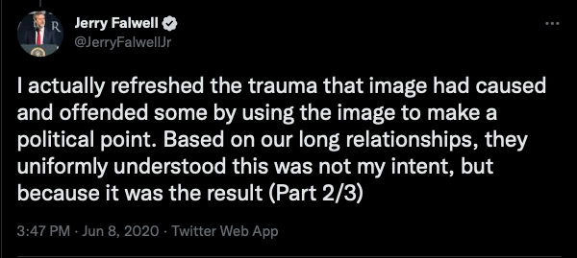
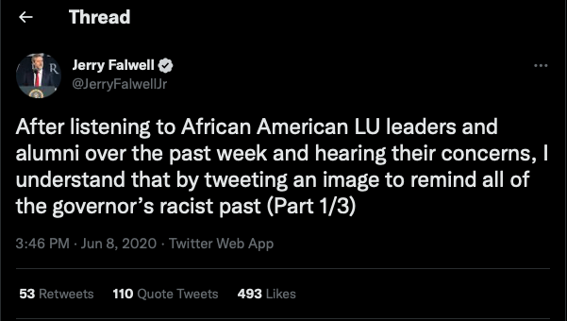
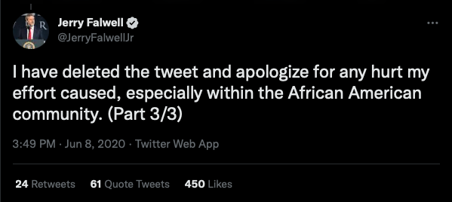
Jerry Falwell Jr. issued an apology on June 8, 2020

Slide 18
Rocky Road for Jerry Falwell Jr.
June 4, 2019
May 27, 2020
June 8, 2020
August 2, 2020
August 7, 2020
Posted and deleted Tweet criticizing David Platt
Posted Tweet criticizing Gov. Northam
Inappropriate Instagram photo
Deleted Tweet criticizing Gov. Northam
Resigned from Liberty University
The (Deleted) Tweets Tell the Story @EmilyEscamilla_

Slide 19
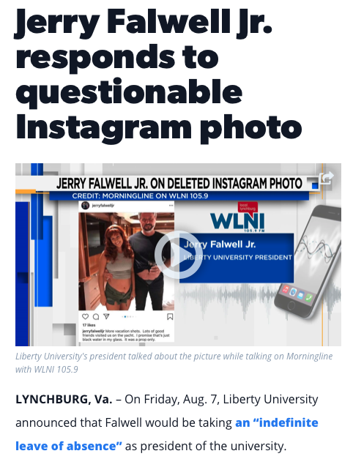
Jerry Falwell Jr. is no longer the President of Liberty University
https://www.wsls.com/news/local/2020/08/06/jerry-falwell-jr-responds-to-questionable-instagram-photo/

Slide 20
Key Takeaways
Need to find the original URL for the tweet
Wild card searches reveal valuable variances
Rely on incidental archiving
Deleted tweets can paint more of a story than the ones that are still public

